Slide 1
Eindhoven Data Science
Hackathon

Slide 2
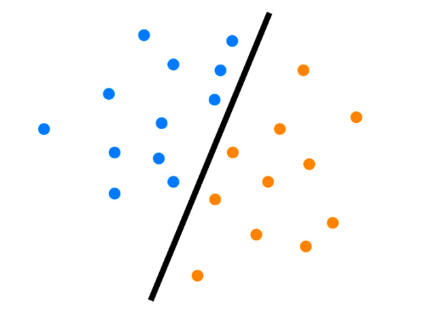
Classification

Slide 3
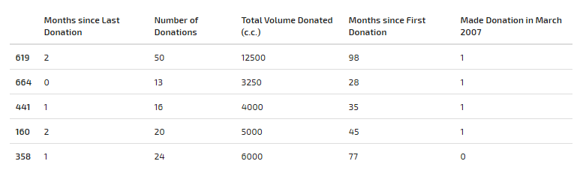








Example: blood donation data
input dataset X with features ( ) and class-label Y
$$x_{1},x_{2},x_{3},x_{4}$$
$$x^{(1)}:$$
$y^{(1)}$ = 1
$$x^{(2)}:$$
$y^{(2)}$ = 1
.
.
.
$y^{(3)}$ = 1
$y^{(4)}$ = 1
$y^{(5)}$ = 0
$x_{1} x_{2}$ $x_{3}$ ${ x}_{4}$
Y: label indicating the class
1: belongs to class
0: does not belong to class

Slide 4









Example: salary data
input dataset X with features ( ) and class-label Y ( , )
$x_{1}, …$, ${ x}_{7}$
$$y^{(1)}$$
$$y^{(2)}$$
age | workclass | education | marital-status | occupation | hours-per-week | native-country | salary
50 | Self-emp | Bachelors | Married-civ-spouse | Exec-managerial | 13 | United-States | <=50K
38 | Private | HS-grad | Divorced | Exec-managerial | 40 | United-States | >50K
53 | Private | 11th | Married-civ-spouse | Cleaners | 40 | Cuba | <=50K
28 | Private | ??? | Married-civ-spouse | Prof-specialty | 40 | Cuba | >50K
37 | Private | Masters | Married-civ-spouse | Prof-specialty | 40 | United-States | <=50K
49 | Private | 9th | Divorced | Other-service | 16 | Jamaica | >50K
$$y^{(1)}=0$$
$$y^{(2)}=1$$
$$y^{(3)}=0$$
$$y^{(4)}=1$$
$$y^{(5)}=0$$
$$y^{(6)}=1$$
$x_{1} x_{2}$ $x_{3}$ ${ x}_{4} x_{5} x_{6} x_{7}$

Slide 5
Example: salary data
input dataset X with features ( ) and class-label Y ( , )
$x_{1}, …$, ${ x}_{7}$
$$y^{(1)}$$
$$y^{(2)}$$
age | workclass | education | marital-status | occupation | hours-per-week | native-country | salary
50 | Self-emp | Bachelors | Married-civ-spouse | Exec-managerial | 13 | United-States | <=50K
38 | Private | HS-grad | Divorced | Exec-managerial | 40 | United-States | >50K
53 | Private | 11th | Married-civ-spouse | Cleaners | 40 | Cuba | <=50K
28 | Private | ??? | Married-civ-spouse | Prof-specialty | 40 | Cuba | >50K
37 | Private | Masters | Married-civ-spouse | Prof-specialty | 40 | United-States | <=50K
49 | Private | 9th | Divorced | Other-service | 16 | Jamaica | >50K
$$y^{(1)}=0$$
$$y^{(2)}=1$$
$$y^{(3)}=0$$
$$y^{(4)}=1$$
$$y^{(5)}=0$$
$$y^{(6)}=1$$
$x_{1} x_{2}$ $x_{3}$ ${ x}_{4} x_{5} x_{6} x_{7}$
Numerical data: need to be normalized
Categorical data: needs to be featurized and then normalized
Missing data : needs to be removed (?)

Slide 6
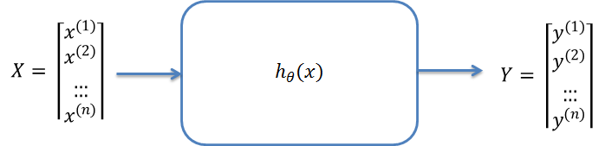
The Classifier
A classifier should correctly map input data to the output values.
It is a model which (hopefully) correctly describes the input data.
Once the model is formed / generated with the training data,
it can be used to evaluate new data.
Notes:
Determine the values of the parameters $θ_{i}$ with the training set
Evaluate it’s accuracy with the test set

Slide 7
Classification
70%
Training Set
Evaluate
Classifier
Classifier
Labeled Data
30%
Test Set

Slide 8
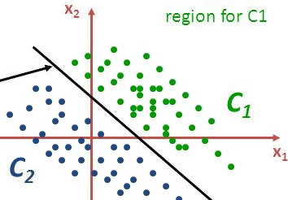



Three popular classifiers
Naive Bayes | Logistic Regression | Support Vector Machines
Uses a Statistical Approach | Uses a functional approach | Uses a Geometrical Approach
weight-vector w
$$h_{θ}(x)$$
class 1
C
A
B
$$h_{θ}\left(x\right)=θ_{0}+θ_{1}x^{(2)}+…+θ_{n}x^{(n)}$$
class 2

Slide 9



Popular ML Libraries
Scikit-learn
NLTK (Tekst Analytics)
e1071
gbm
glm
WEKA
Java-ML
Mllib (Spark)

Slide 10
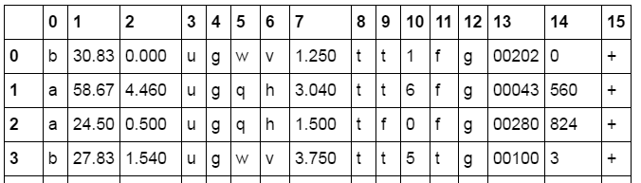
Let’s get started!
Japanese credit dataset;
15 features + label (9 categorical, 6 numerical)
690 instances

Slide 11
Let’s get started!
IMDB movie review dataset;
Training set of 25.000 entries (positive and negative reviews)
Test set of 25.000 entries

